Slide 1

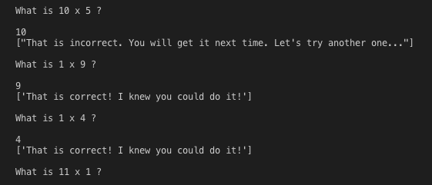
Gen Z Multiplication Flash Cards A software designed to adapt to Gen Z technological mathematics learning
Coders: Allison Smith & Paris Vo
https://github.com/ksu-is/GenZMultiplicationFlashcards
Source: https://github.com/plasmonresonator/MultiplicationFlashCards

